Slide 1
Bionic Ears

Slide 2
By the end of this lesson, you should be able to:
Explain the three different types of hearing loss.
Describe how cochlear implants work.
Explain the impact that bionic ears have on the hearing impaired.

Slide 3
1 in 6 Australians currently suffer from hearing loss.
There are multiple types of technology used to assist people who have partial or complete loss of hearing. Cochlear implants are one type of hearing technology available.
In this Smart Lesson you will learn about the development of cochlear implants, also known as bionic ears.

Slide 4
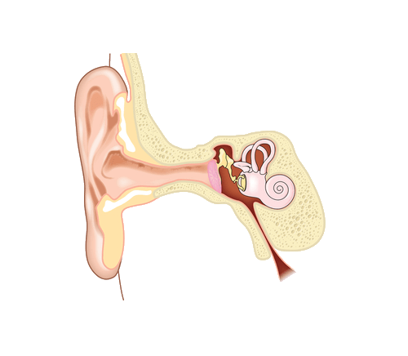
But first up, let's find out how a healthy ear works.
A healthy ear has three functioning sections. These sections are called the outer, middle and inner ears.
Each section works in a different way to transmit the sound we hear in the environment to our brain.

Slide 5
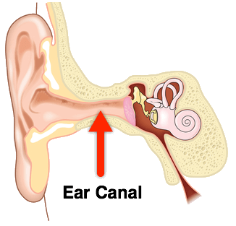
The two main structures in the outer ear are the pinna and the ear canal.
The pinna funnels sound from the environment into the ear canal. Sound is transported through the ear canal towards the ear drum.

Slide 6
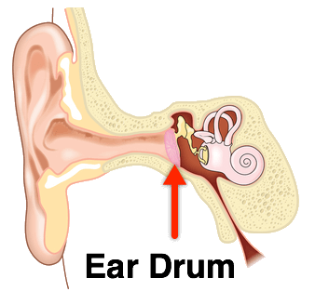
The main structures of the middle ear are the ear drum and the ossicles.
After passing through the ear canal, sound waves vibrate the ear drum. This movement causes the ossicles (the three tiny bones in the ear) to magnify the vibrations and pass the sound on to the inner ear.

Slide 7
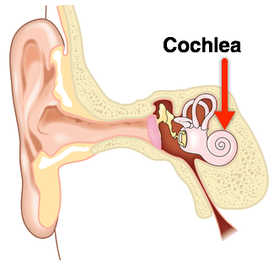
The main structures of the inner ear are the cochlea and sensory hair cells.
The cochlea is a spiral shaped tube filled with fluid. When sound reachers the inner ear, the fluid inside the cochlea vibrates. This movement is detected by the sensory hair cells that line cochlea. The hair cells convert the vibrations into electric signals, which they transfer to the brain via the auditory nerve.

Slide 8
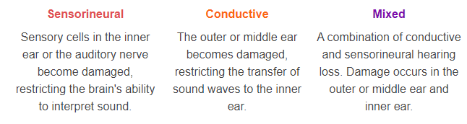
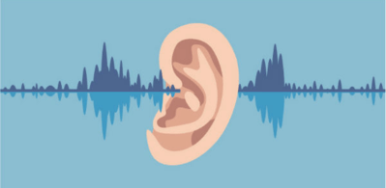
Damage can occur to all three sections of the ear.
Ear damage can lead to hearing loss and complete deafness. There are three different types of hearing loss:

Slide 9
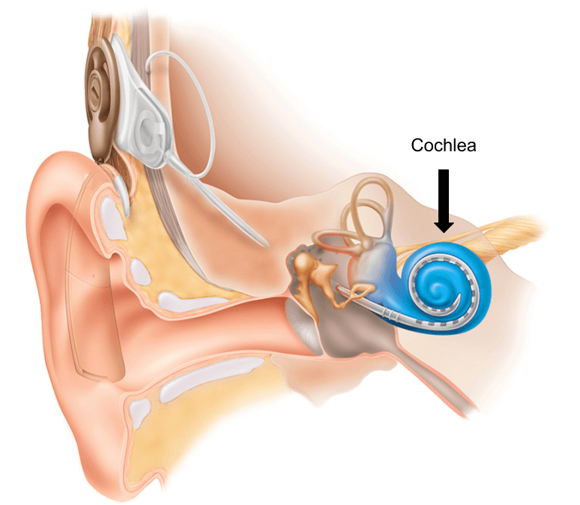
In Australia, hearing aids and cochlear implants are the two most common devices used by people with hearing loss.
Cochlear implants are much more specialised than hearing aids and target sensorineural hearing loss. The implant actually takes the place of damaged parts of the inner ear. It is able to send electric signals from the inner ear to the brain to be interpreted as sound.

Slide 10

Cochlear implants are popular in Australia.
Sydney Cochlear Implant Centre (SCIC) and Royal Institute for Deaf and Blind Children (RIDBC) are two groups that have joined together to create Australia’s largest cochlear implant program - the SCIC Cochlear Implant Program.
They provide cochlear information, implantation, rehabilitation, therapy, education and early intervention for people of all ages around Australia.

Slide 11

Cochlear implants help with certain types of hearing loss.
Cochlear implants are useful for people who have sensorineural hearing loss. Cochlear implants take the place of the damaged cochlea, a structure of the inner ear, and send sound signals to the brain.

Slide 12
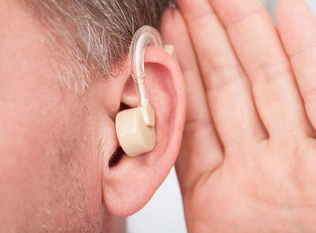
Hearing aids and cochlear implants are not the same thing.
They target different kinds of hearing loss.
Cochlear implants do the job of the inner ear, whereas hearing aids only make sound louder. Hearing aids don't work well if the hearing sensory cells in the inner ear are damaged.

Slide 13
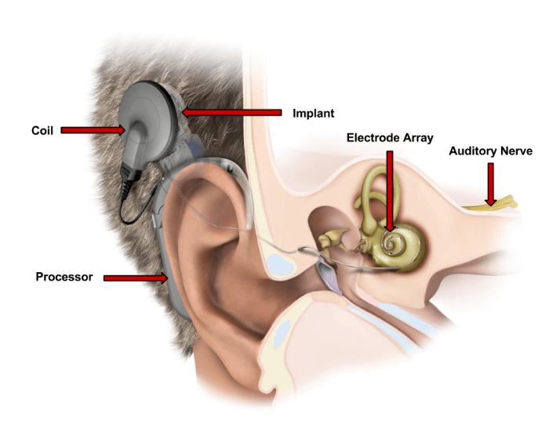
How do cochlear implants work?
A sound processor and coil is worn around the ear. Two microphones in the processor detect sounds and turn them into digital signals. The digital signals are transmitted by the coil through the skin to an implant.
The implant converts the digital signals into electric signals, which travel down to an electrode array implanted in the cochlea. The electric signals bypass the damaged sensory hair cells and directly stimulate the auditory nerve, which sends sound signals to the brain.

Slide 14


Slide 15

Cochlear implants can help people hear.
Cochlear implants can help people with moderate to profound sensorineural hearing loss in both ears, or profound sensorineural hearing loss in one ear but normal hearing in the other.
Most people choose to have an implant in both ears because it improves the ability of the ears to determine the direction of a sound. It also helps them to focus when they are in a noisy area.

Slide 16
Whether or not cochlear implants work depends on a few factors, including:
How long hearing had been lost for
The severity of hearing loss
The condition of the inner ear
Other medical conditions
The amount of practice with the implant system

Slide 17

Cochlear implants are very beneficial for the hearing impaired.
The implants can provide immediate hearing improvements and allow people with hearing impairments to carry out regular activities, like having a conversation, using the phone and enjoying music.

Slide 18

Early-onset deafness can cause hearing loss in children in the very early stages of their life.
Between the ages of six months and one year, children begin to pair sounds and speech with meaning. If they are unable to hear during this time, their ability to learn to talk and understand speech is disrupted.

